Slide 1

Geospatial AI Site Selection
A Production-Ready PU Learning Pipeline for Luxury Cafes in Lahore
Team: Abuhurairah Faheem (BSCS23077) • Muhammad Ammar Bin Talib (BSCS23143)

Slide 2

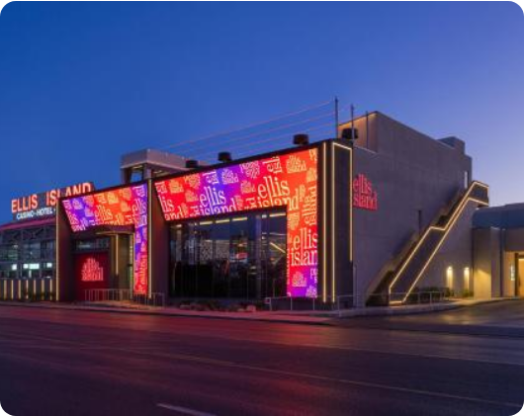
1. Problem Statement & Objectives
The Goal: Transition from intuition-based to data-driven site selection for luxury cafes to maximize ROI and footfall.
The Challenge: Finding highly profitable "Blue Ocean" locations in a rapidly saturating market, avoiding areas controlled by massive competitors.
The Solution: A machine learning pipeline that mathematically scores the socio-economic DNA of 3,691 distinct physical locations across the city.

Slide 3






2. Dataset & Preprocessing
Note: No pre-existing dataset existed for this problem. We engineered this entirely from scratch.
H3 Spatial Grid
Feature Engineering
IDW Imputation
Mapped Lahore into 3,691 Uber H3 Hexagons (Resolution 9) to create a standardized, un-biased spatial matrix for the AI.
Compiled and aggregated raw geographic data from OpenStreetMap, Kontur Nighttime Population, and Graana Real Estate listings.
Solved missing rent data in the city outskirts using Inverse Distance Weighting (k=5) to guarantee continuous mathematical gradients.

Slide 4




3. Methodology & Models
PU Learning w/ XGBoost
Business Dispatch Sort
The Approach: Trained an XGBoost Bagging Ensemble (100 bags).
The AI Limit: Decision trees caused "Leaf Node Quantization," resulting in mathematical ties for top-tier elite locations.
Why PU Learning? We only have data for successful cafes (Positives). The rest of the city is Unlabeled, not strictly negative. PU Learning isolates "reliable negatives" dynamically rather than assuming empty areas are bad.
The Operational Fix: Implemented a Tier-2 production layer. Tied AI probabilities are deterministically ranked by Distance to CBD and Population to create actionable dispatch routes.

Slide 5

4. Results & Evaluation
Moving Beyond standard PR-AUC
Feature Importance: Luxury Density and Rent proved to be the highest predictive drivers globally.
The PU Paradox: Our Baseline model scored a higher PR-AUC purely by memorizing known cafes. XGBoost scored lower on paper, but successfully explored entirely new "Blue Ocean" territories.
Actionable UI Shortlist
Production Ready: Applied strict GIS masks to prevent the AI from recommending unbuildable zones (rivers, graveyards).

Slide 6

5. Live Demo & Future Work
Transition to Folium Map
Future Upgrades
Moving to the live dashboard to view the interactive Top 50 Hexagons, displaying the SHAP logic and final probabilities.
• Spatial Cannibalization (NMS): Preventing overlapping recommendations. • Temporal Dynamics: Integrating hourly footfall data.

